Slide 1
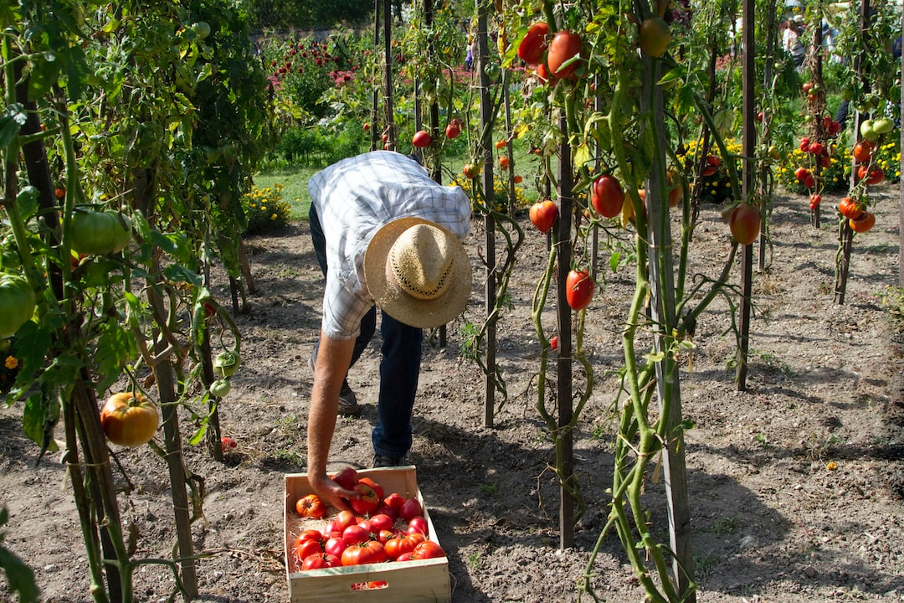


Plant Disease Detection System using Image Classification
-by Oishani Ghosh
M.Sc. C.S. - 4th sem.
2110015015013
Department of Computer Science
University of Lucknow

Slide 2
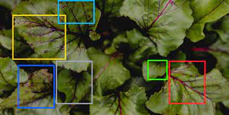
Introduction
THE AGRICULTURE INDUSTRY PLAYS A VITAL ROLE IN ENSURING FOOD SECURITY AND SUSTAINABLE DEVELOPMENT. HOWEVER, PLANT DISEASES POSE A SIGNIFICANT THREAT TO CROP YIELDS AND OVERALL AGRICULTURAL PRODUCTIVITY. EARLY DETECTION AND ACCURATE DIAGNOSIS OF PLANT DISEASES ARE CRUCIAL FOR TIMELY INTERVENTION AND EFFECTIVE CONTROL MEASURES. IN THIS PROPOSAL, WE PRESENT THE CONCEPT OF DEVELOPING A PLANT DISEASE DETECTION SYSTEM USING IMAGE PROCESSING TECHNIQUES TO AID FARMERS AND AGRICULTURAL EXPERTS IN IDENTIFYING AND MANAGING CROP DISEASES.

Slide 3

Problem Statement
THE IDENTIFICATION OF PLANT DISEASES TRADITIONALLY RELIES ON VISUAL INSPECTION BY FARMERS AND EXPERTS, WHICH CAN BE TIME-CONSUMING, SUBJECTIVE, AND PRONE TO HUMAN ERROR.
THE EXPERTISE REQUIRED FOR ACCURATE DIAGNOSIS MAY NOT ALWAYS BE AVAILABLE IN REMOTE OR RESOURCE-CONSTRAINED AREAS.

Slide 4
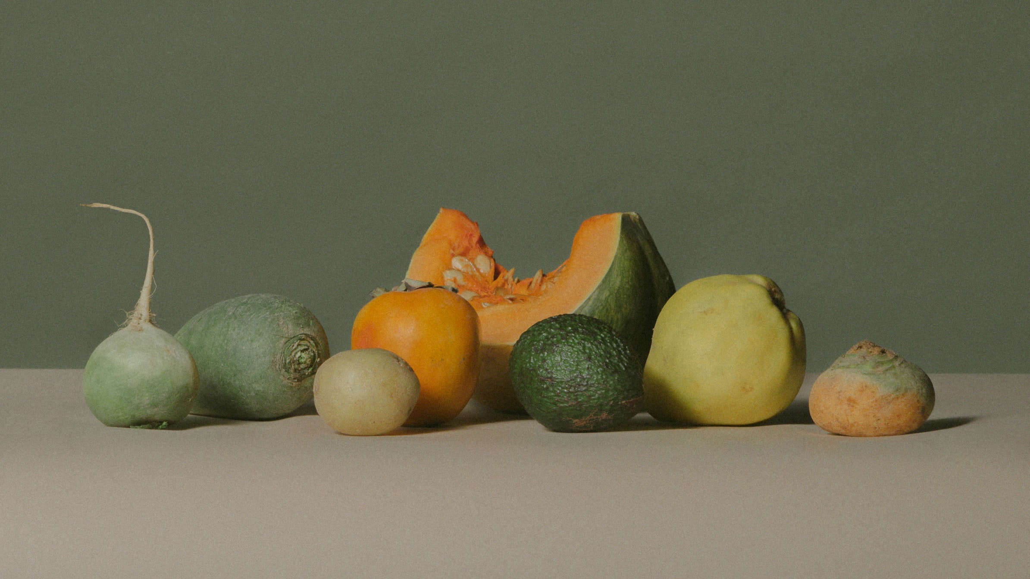
Aim:
This project aims to address these challenges by leveraging image processing techniques to automate and enhance the plant disease detection process, thereby facilitating early and accurate disease identification.
Objectives:
Implementing Deep Learning model with Transfer Learning technique to classify plant leaf images
Creating a UI for detection of plant diseases
Real-time detection of disease in plant leaves

Slide 5
Literature Survey
Name of the paper: Plant Disease Detection Using Image Processing and Machine Learning
Authors:Kulkarni, P., Karwande, A., Kolhe, T., Kamble, S., Joshi, A. and Wyawahare, M. (2021)
Method Used:Digital Image Processing and Random Forest
Description:They developed a computer vision based system for plant disease detection with average 93% accuracy and 0.93 F1 score. Also the proposed system is computationally efficient because of the use of statistical image processing and machine learning model.
Name of the paper: Leaf Disease Detection and Classification by Decision Tree
Authors:Rajesh, B., Sai Vardhan, M.V. and Sujihelen, L. (2020)
Method Used:Decision Tree
Description:This proposed system uses a decision tree to identify and classify leaf disease and increases its detection accuracy with less time compared with the existing system.

Slide 6





BENEFITS OF PLANT DISEASE DETECTION SYSTEM
Time and Cost Efficiency:
Increased Agricultural Productivity:
Early Disease Detection:
The system reduces the time required for disease identification, enabling farmers to take timely preventive measures. It also minimizes the need for extensive field visits by experts, resulting in cost savings.
By automating the detection process, the system can identify plant diseases at their early stages, allowing for prompt action and preventing the spread of diseases.
Accuracy and Reliability:
By enabling early intervention and targeted disease management, the system contributes to improved crop health, higher yields, and enhanced agricultural productivity.
Image processing algorithms provide objective and consistent results, reducing the reliance on subjective human judgment and increasing the accuracy of disease diagnosis.

Slide 7
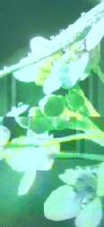


Methodology and Approach
Data Collection and Pre-processing – use of Plant Village dataset from Kaggle
Feature Extraction
NN Model Architecture and Training
Model Evaluation
UI Development
Real time Plant and plant disease detection
Waterfall model, that follows a sequential and linear approach will be used here
Python for ML
Python Flask API
HTML/CSS/JS
Libraries like pandas, TensorFlow, numpy, etc. will be used
ML Model Implementation
Transfer Learning and EfficientNetB3
Model Evaluation using accuracy
Designing user interface
Designing Flask app
Designing index.htm
Integration and testing
Flask API
Leaf image upload and prediction

Slide 8
DFD
DFD
Image Pre-processing
Image Pre-processing
Feature Extraction
Input Plant image
Feature Extraction
Input Plant image
Neural Network Model
Training images set
Neural Network Model
Training images set
Plant Leaf class/type
Images from loaded dataset
Plant Leaf class/type
Images from loaded dataset
Unhealthy
Healthy
Unhealthy
Healthy

Slide 9
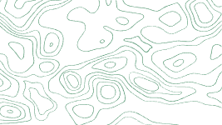
Interactive and easy-to-use UI to make the farmers independent of technological constraints
Real-time plant disease detection for farmers and students in the field of Agriculture
Image Processing for plant leaf image classification based on diseases
Use of Adam's Optimizer for enhancing the performance of the NN model
Key Features

Slide 10
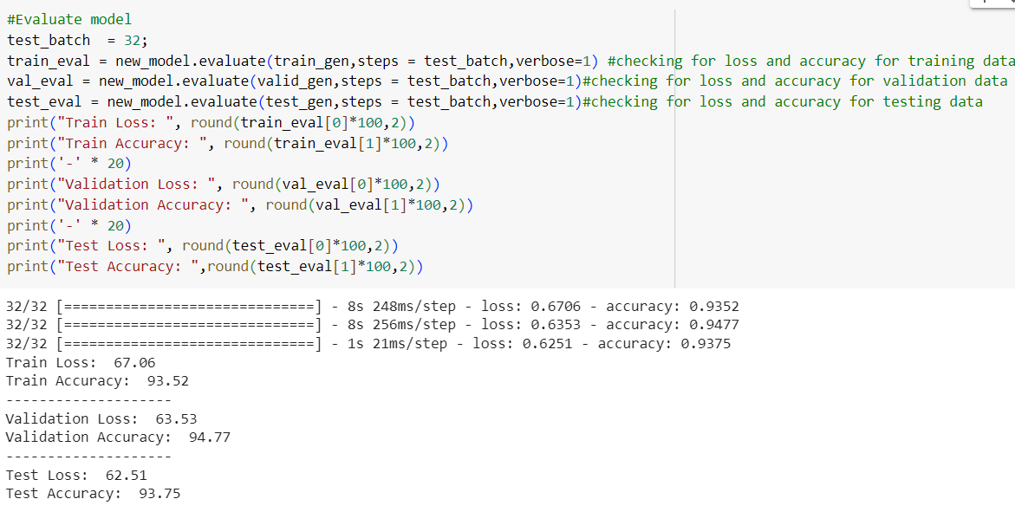
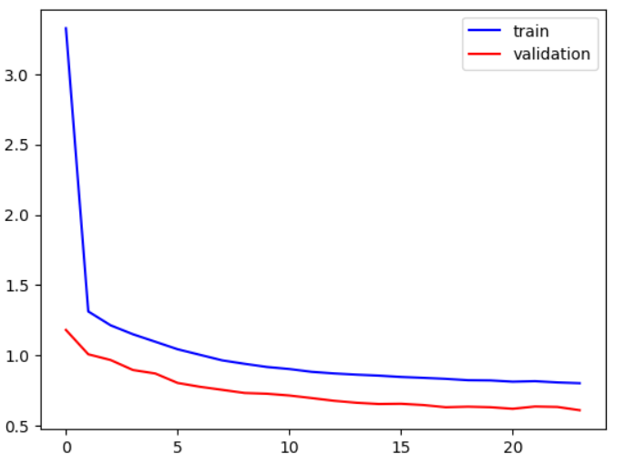
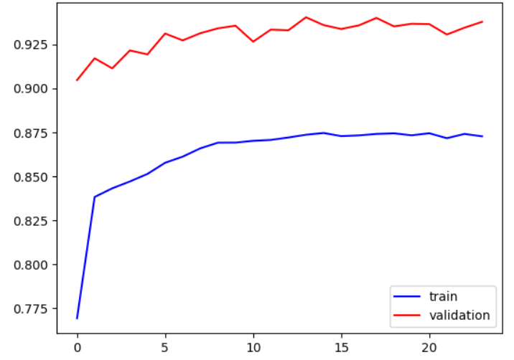
ML Model Performance
Training and Validation Accuracy Curve
NN Model Evaluation
Training and Validation Loss Curve

Slide 11

Plant Leaf Disease Detection System Interface
App with no image uploaded
It lets you upload the plant leaf image to be diagnosed.
Once you click on ‘Upload and Detect’ button after uploading the image, it gives Prediction Result
The Prediction Result consists of Leaf Type, Confidence and Category

Slide 12

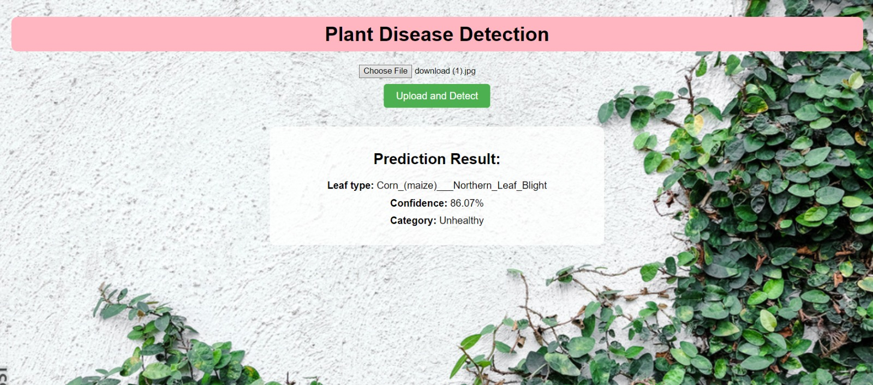
Prediction for Healthy Leaf with Leaf type Categorization
Prediction for Unhealthy Leaf with Leaf type Categorization

Slide 13

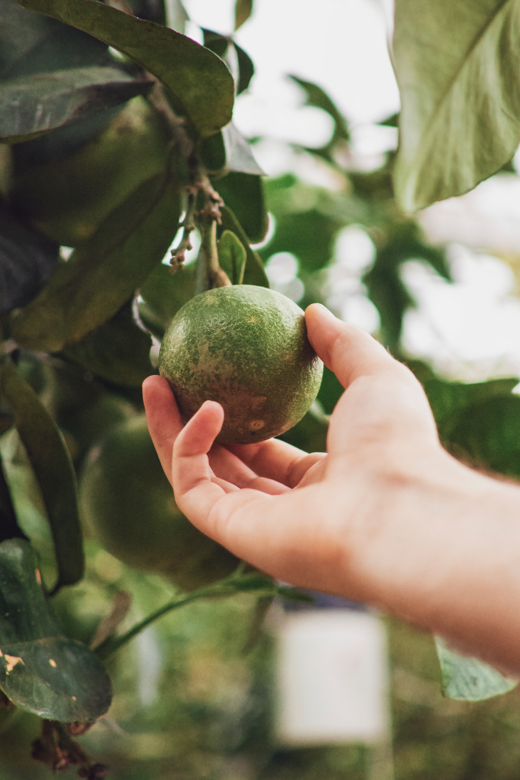
Thank You!

